Slide 1
Lexicosyntactic Inference in Neural Models
Aaron Steven White
University of Rochester
Rachel Rudinger
Johns Hopkins University
Kyle Rawlins
Johns Hopkins University
Benjamin Van Durme
Johns Hopkins University

Slide 2
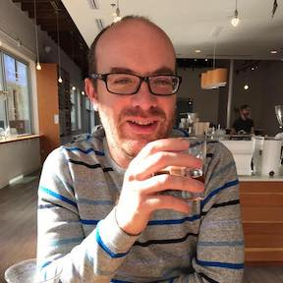
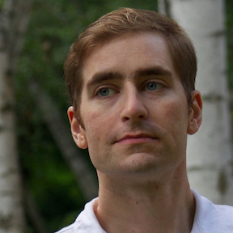
Coauthors
Rachel Rudinger
Kyle Rawlins
Ben Van Durme

Slide 3


All data freely available!
Decompositional Semantics Initiative
MegaAttitude
Project
decomp.io
megaattitude.io

Slide 4
Neural models are dominant among natural language inference and event extraction systems.
What types of inferences can neural models capture?
Jo kicked the ball to Bill
Bill received the ball.
John doesn’t have the ball.
The ball moved.

Slide 5
Lexical inference
Some inferences appear computable from lexical items alone.
I won't forget about the $.
I know about the $.

Slide 6
Lexicosyntactic inference
Not all inferences are computable from a lexical item alone.
Did he forget that he already has a memoir called "A Charge to Keep"?
He already has a memoir.
Kiparsky and Kiparsky, 1970; Karttunen, 1971a,b; Horn, 1972; Karttunen and Peters, 1979; Heim, 1992; Simons, 2001, 2007; Simons et al., 2010; Abusch, 2002, 2010; Gajewski, 2007; Anand and Hacquard, 2013, 2014

Slide 7
Lexicosyntactic inference
Not all inferences are computable from a lexical item alone
sorry for not sending it to you earlier (totally forgot to open my outlook).
???
Outlook was not opened.
Kiparsky and Kiparsky, 1970; Karttunen, 1971a,b; Horn, 1972; Karttunen and Peters, 1979; Heim, 1992; Simons, 2001, 2007; Simons et al., 2010; Abusch, 2002, 2010; Gajewski, 2007; Anand and Hacquard, 2013, 2014

Slide 8
Lexicosyntactic inference
Appears to arise from an interaction between the verb and its syntactic structure (in this case, it’s embedded clause)
verb
clause
verb
clause
…forgot to open outlook.
…forgot that he had a memoir.
Refer to this phenomenon as lexicosyntactic inference.

Slide 9
This talk
How well do neural models capture lexicosyntactic inference? Focus: English clause-embedding verbs
Build a new dataset – MegaVeridicality2 – focused on lexicosyntactic inference in English clause-embedding verbs
Use event factuality prediction (EFP) to probe SOTA EFP neural models’ ability to capture lexicosyntactic inference.
Nairn et al., 2006; Sauri and Pustejovsky, 2009, 2012; de Marneffe et al., 2012

Slide 10
Why Event Factuality Prediction?
Unlike general natural language inference, EFP itself is relatively constrained.

Slide 11
Task: Event Factuality Prediction
Given a text and a highlighted predicate, predict whether the event referred to by the predicate happened.
forgot to open outlook.
DIDN’T HAPPEN

Slide 12
Event Factuality Datasets
Now a variety of datasets for training and testing EFP systems
FactBank (9,761 predicates) Sauri & Pustejovsky 2009, 2012
UW (13,644 predicates) Lee et al. 2015
MEANTIME (1,395 predicates) Minard et al. 2016
UDS (27,289 predicates) White et al. 2016, Rudinger et al. 2018
Available at decomp.io
Unified factuality representation [-3, 3]
Stanovsky et al. 2017 (following Lee et al. 2015)

Slide 13
Why Event Factuality Prediction?
Unlike general natural language inference, EFP itself is relatively constrained.
Best performing neural models for EFP are simple instances of common baseline models
Rudinger et al. 2018

Slide 14
State of the art for EFP
Tree biLSTM
Linear biLSTM
Hybrid biLSTM
Rudinger et al. 2018

Slide 15
Findings
Current SOTA neural models for EFP…
…not robust to variation in lexical item and syntactic structure.
…can’t correctly compute “inverse” inferences.

Slide 16
Outline
Background: Event Factuality Prediction (EFP)
New Dataset: MegaVeridicality2
Experiment: SOTA EFP system on MegaVeridicality2
Analysis: what does SOTA system get wrong?

Slide 17
Dataset
MegaVeridicality2

Slide 18
MegaVeridicality
MegaVeridicality1
Veridicality judgments for 517 verbs from the MegaAcceptability dataset based on acceptability in [NP _ed that S] and [NP was _ed that S] frames White and Rawlins 2016, 2018

Slide 19
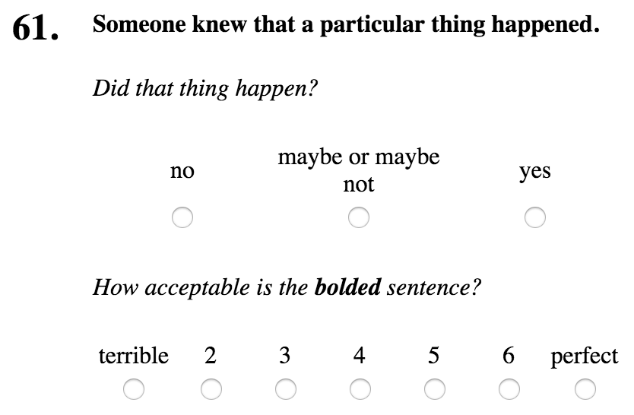
NP
_ed
that S

Slide 20
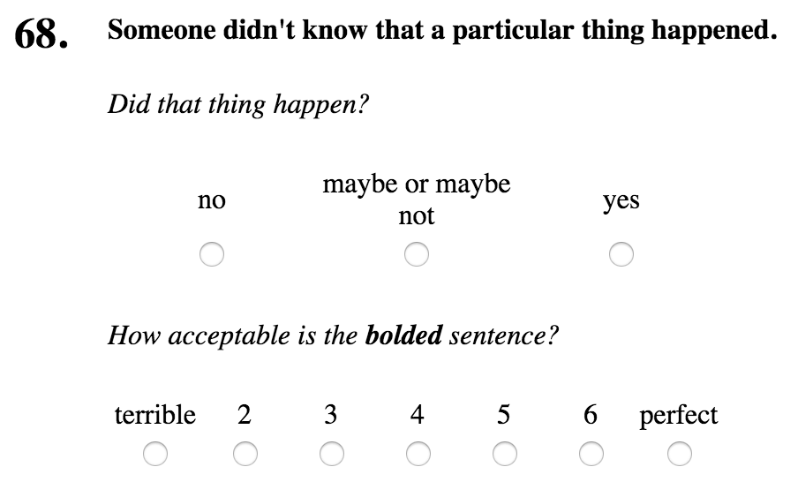
matrix polarity= negative

Slide 21
matrix polarity= positive

Slide 22
MegaVeridicality
MegaVeridicality1
Veridicality judgments for 517 verbs from the MegaAcceptability dataset based on acceptability in [NP _ that S] and [NP was _ed that S] frames White and Rawlins 2016, 2018

Slide 23
MegaVeridicality
MegaVeridicality1
Veridicality judgments for 517 verbs from the MegaAcceptability dataset based on acceptability in [NP _ that S] and [NP was _ed that S] frames White and Rawlins 2016, 2018
MegaVeridicality2
Extend MegaVeridicality1 with 603 verb types from MegaAcceptability based on acceptability in 7 frames involving infinitival complements
Available at megaattitude.io

Slide 24
Examples
NP _ed for NP to VP
Someone {wanted, didn’t want} for a particular thing to happen.
NP _ed NP to VP[+ev]
Someone {told, didn’t tell} a particular person to do a particular thing.
NP _ed to VP[-ev]
A particular person {hoped, didn’t hope} to have a particular thing.

Slide 25
Verbs in MegaVeridicality2

Slide 26
Verbs in MegaVeridicality2
MegaVeridicality1

Slide 27
Data collection + postprocessing
2,850 items randomly partitioned into 50 lists of 57
10 responses per item from 10 different crowdsource workers
Responses for each item (verb+frame+matrix) mapped to single continuous number using ordinal mixed effects model
Like z-scoring, controls for annotator variability in use of scale

Slide 28
Experiment
SOTA EFP system on MegaVeridicality2

Slide 29
Experiment
Predict factuality of event described by embedded predicate in all MegaVeridicality2 sentences
s/a particular person/someone/
s/a particular thing/something/
Someone knew that something happened

Slide 30
Experiment
Metric: correlation between predicted and true factuality
Lee et al. 2015, Stanovsky et al. 2017, Rudinger et al. 2018
See paper for details on various experimental manipulations
Ablation experiments on predicate information
Various kinds of offline ensembles
Analysis of embedding space

Slide 31
Correlation: true v. predicted

Slide 32
Correlation: true v. predicted

Slide 33
Correlation: true v. predicted

Slide 34
Correlation: true v. predicted

Slide 35
Correlation: true v. predicted

Slide 36
Correlation: true v. predicted

Slide 37
Correlation: true v. predicted

Slide 38
Findings
SOTA EFP models are not robust to variation in lexical item and syntactic structure.

Slide 39
Analysis
Where does the SOTA EFP system fail?

Slide 40
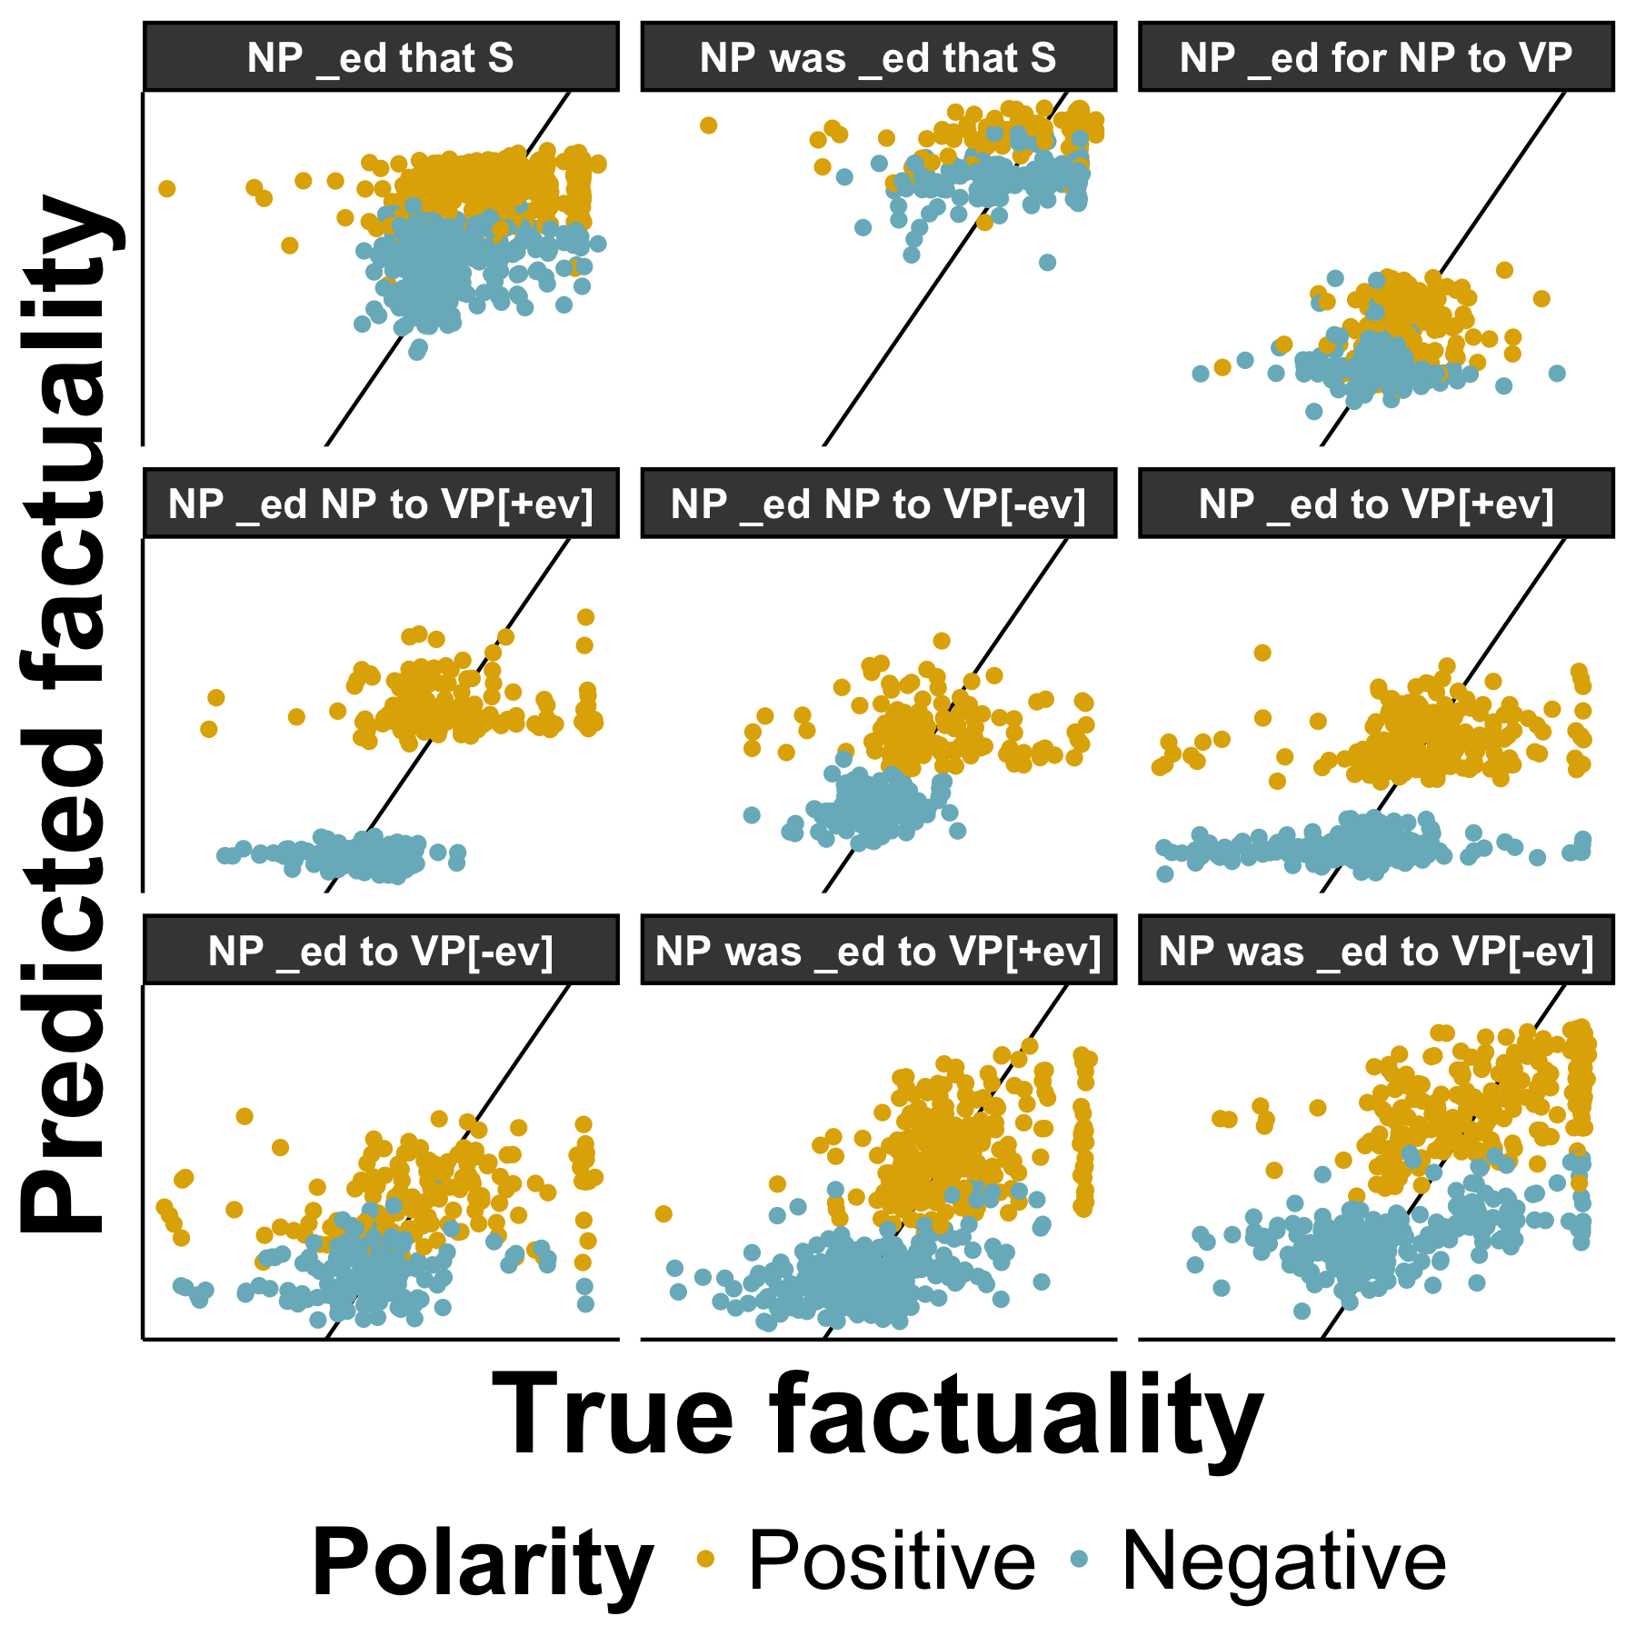
Neural model predictions

Slide 41
Neural model predictions

Slide 42
Neural model predictions

Slide 43
Neural model predictions
See paper for a regression analysis of which combinations of syntactic features are predicted worst
For talk, look at items with highest abs error

Slide 44
Neural model predictions
Someone faked that something happened

Slide 45
Neural model predictions
Someone faked that something happened
Someone was misinformed that something

Slide 46
Neural model predictions
Someone faked that something happened
Someone was misinformed that something
Someone neglected to do something

Slide 47
Neural model predictions
Someone faked that something happened
Someone was misinformed that something
Someone neglected to do something
Someone pretended to have something
Someone was misjudged to have something
Someone forgot to have something
Someone neglected to have something
Someone pretended that something happened
Someone declined to do something
Someone was refused to do something
Someone refused to do something
Someone pretended to do something
Someone disallowed someone to do something
Someone was declined to have something
Someone declined to have something
Someone didn’t hesitate to do something

Slide 48
Neural model predictions
Someone faked that something happened
Someone was misinformed that something
Someone neglected to do something
Someone pretended to have something
Someone was misjudged to have something
Someone forgot to have something
Someone neglected to have something
Someone pretended that something happened
Someone declined to do something
Someone was refused to do something
Someone refused to do something
Someone pretended to do something
Someone disallowed someone to do something
Someone was declined to have something
Someone declined to have something
Someone didn’t hesitate to do something

Slide 49
Findings
SOTA EFP models are not robust to variation in lexical item and syntactic structure.
Part of this lack of robustness has to do with not correctly computing “inverse” inferences relative to negation.

Slide 50
Conclusion

Slide 51
Conclusion
Goal: probe neural models lexicosyntactic inference capabilities
Task: event factuality prediction
Data: type-level veridicality judgements for all English clause-embedding verbs in various syntactic contexts
Finding: current SOTA neural models for EFP…
…are not robust to variation in lexical item and syntactic structure.
…do not correctly compute “inverse” inferences relative to negation.
Future work: improving performance on lexicosyntactic inference through pre-training on type-level data.

Slide 52
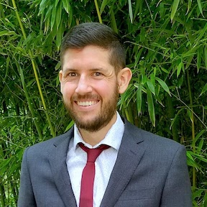
Thanks!

Slide 53
All data freely available!
Decompositional Semantics Initiative
MegaAttitude
Project
decomp.io
megaattitude.io

Slide 54
Appendix

Slide 55
Distribution of inferences

Slide 56
Distribution of inferences

Slide 57
Distribution of inferences
Someone knew that a particular thing happened.

Slide 58
Distribution of inferences
Someone knew that a particular thing happened.
Someone didn’t know that a particular thing happened.

Slide 59
Distribution of inferences
+
o
-

Slide 60
Distribution of inferences
-
o
+

Slide 61
Distribution of inferences

Slide 62
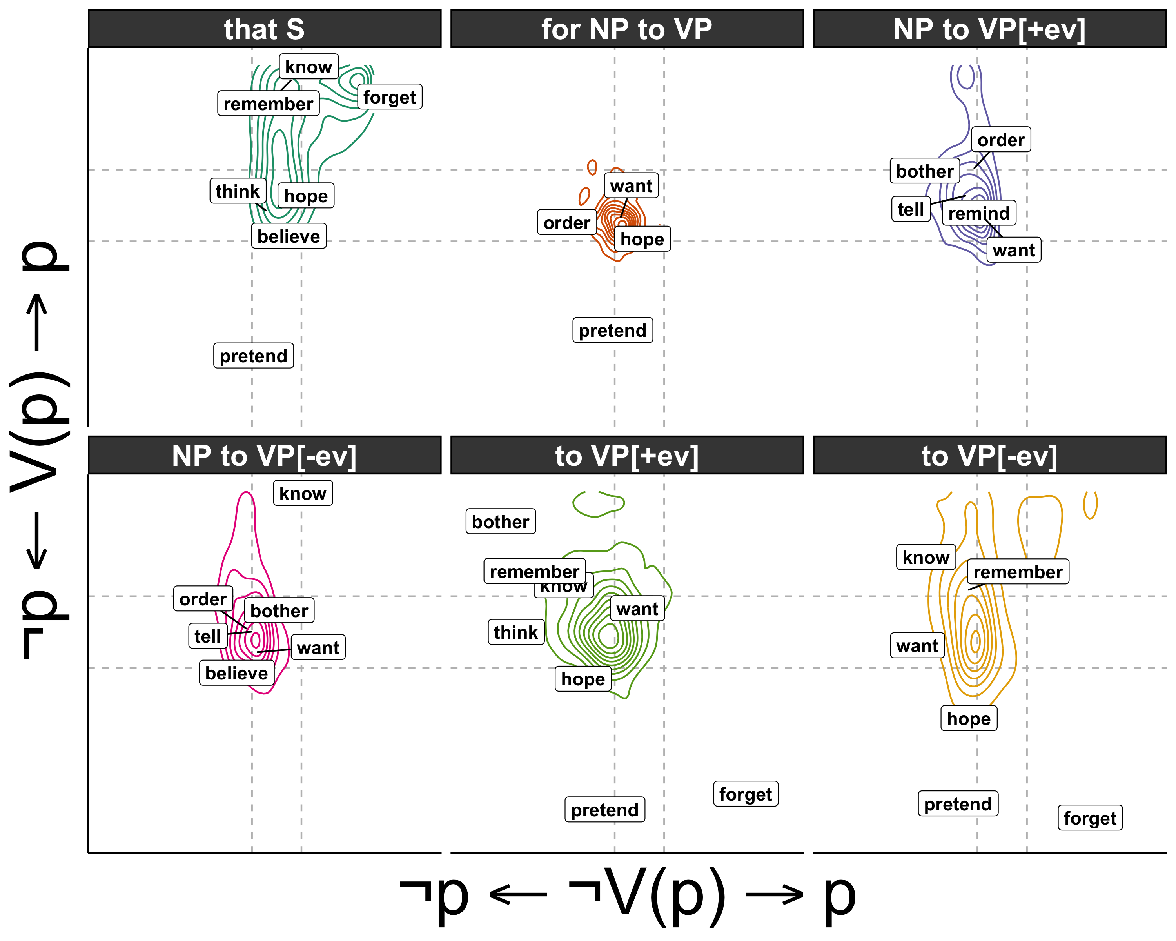
Distribution of inferences
Someone {didn’t forget, forgot} that a particular thing happened.

Slide 63
Distribution of inferences
Someone {didn’t forget, forgot} that a particular thing happened.
Someone {didn’t forget, forgot} to do a particular thing happened.

Slide 64
Distribution of inferences

Slide 65
Distribution of inferences

Slide 66
Distribution of inferences

Slide 67
Distribution of inferences

